Slide 1


Basics of C++
Siddhant Saxena

Slide 2
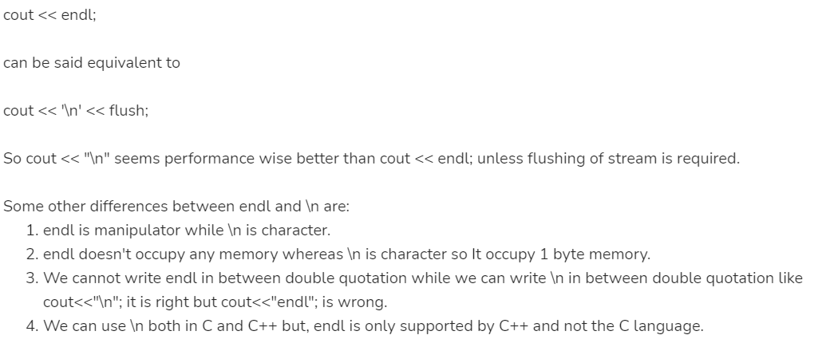

C++ Program Structure
#include <iostream>
using namespace std;
int main()
{
cout << "Hello World";
return 0;
}

Slide 3
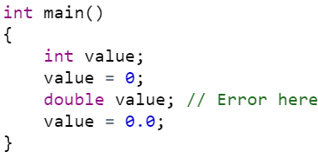
<bits/stdc++.h>
Namespaces
Namespaces allow us to group named entities that otherwise would have global scope into narrower scopes, giving them namespace scope. This allows organizing the elements of programs into different logical scopes referred to by names. Namespace is a feature added in C++ and not present in C.
A namespace is a declarative region that provides a scope to the identifiers (names of the types, function, variables etc) inside it.
Multiple namespace blocks with the same name are allowed. All declarations within those blocks are declared in the named scope.
Advantages of bits/stdc++
In contests, using this file is a good idea, when you want to reduce the time wasted in doing chores; especially when your rank is time sensitive.
This also reduces all the chores of writing all the necessary header files.
You don’t have to remember all the STL of GNU C++ for every function you use.
Value has a previous declaration as previous int

Slide 4
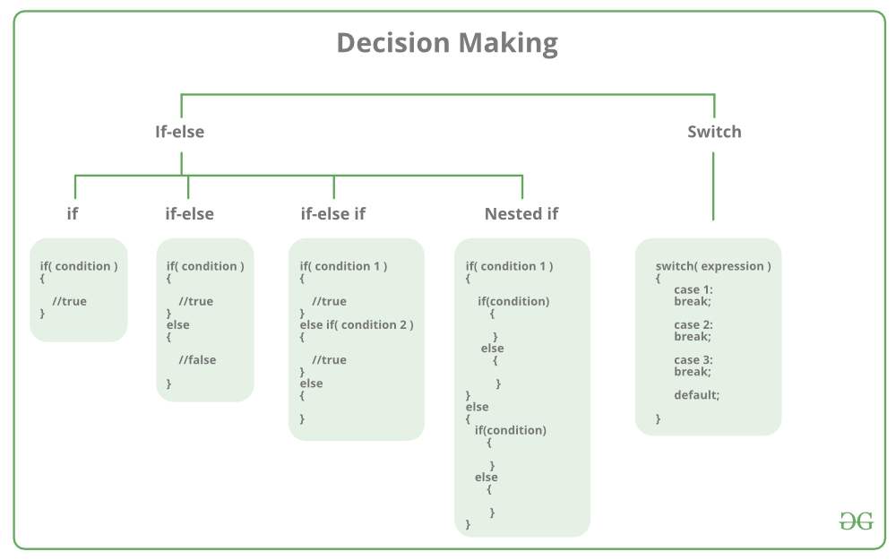

Slide 5

Loops
// C program to illustrate while loop
#include<stdio.h>
int main()
{
// initialization expression
Int i= 1;
while (i< 6)
{
printf( "Hello World\n");
// update expression
i++; }
return 0;
}
#include <iostream>
using namespacestd;
int main () {
for( ; ; ) {
printf("This loop will run forever.");
}return 0;
}
#include <stdio.h>
int main(){
int i=0;
for (i = 1; i <= 10; i++)
{
……………………
}
return 0;
}

Slide 6
#include <iostream>
using namespace std;
int main() {
int rows, coef = 1;
cout << "Enter number of rows: ";
cin >> rows;
for(int i = 0; i < rows; i++){
for(int space = 1; space <= rows-i; space++)
cout <<" ";
for(int j = 0; j <= i; j++){
if (j == 0 || i == 0)
coef = 1;
else coef = coef*(i-j+1)/j;
cout << coef << " ";
}
cout << endl;
}
return 0;
}
Pascal's triangle
1
1 1
1 2 1
1 3 3 1
1 4 6 4 1
1 5 10 10 5 1

Slide 7
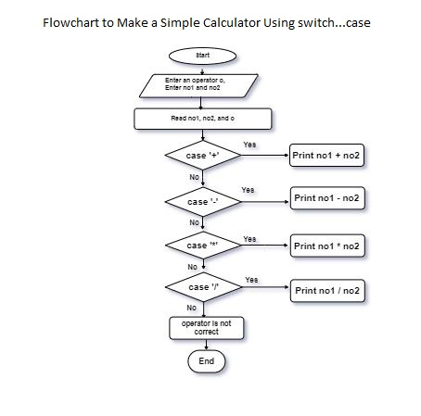
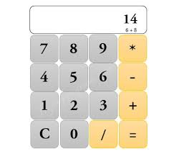
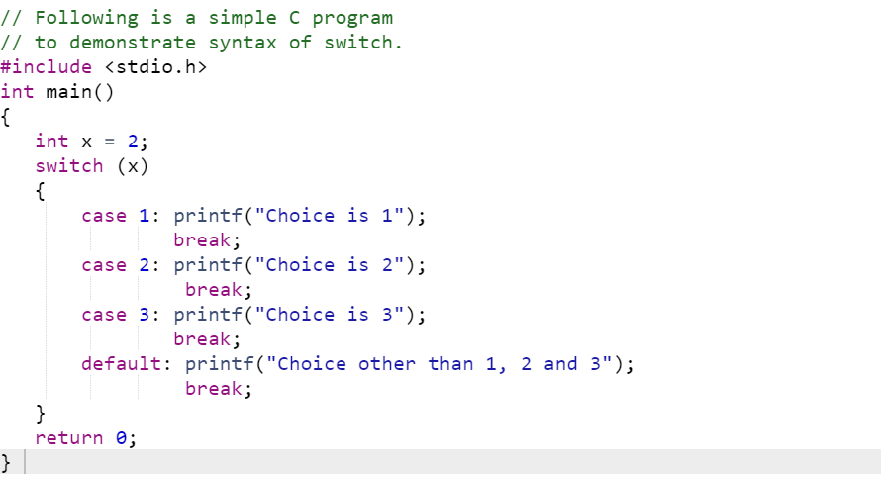
switch

Slide 8
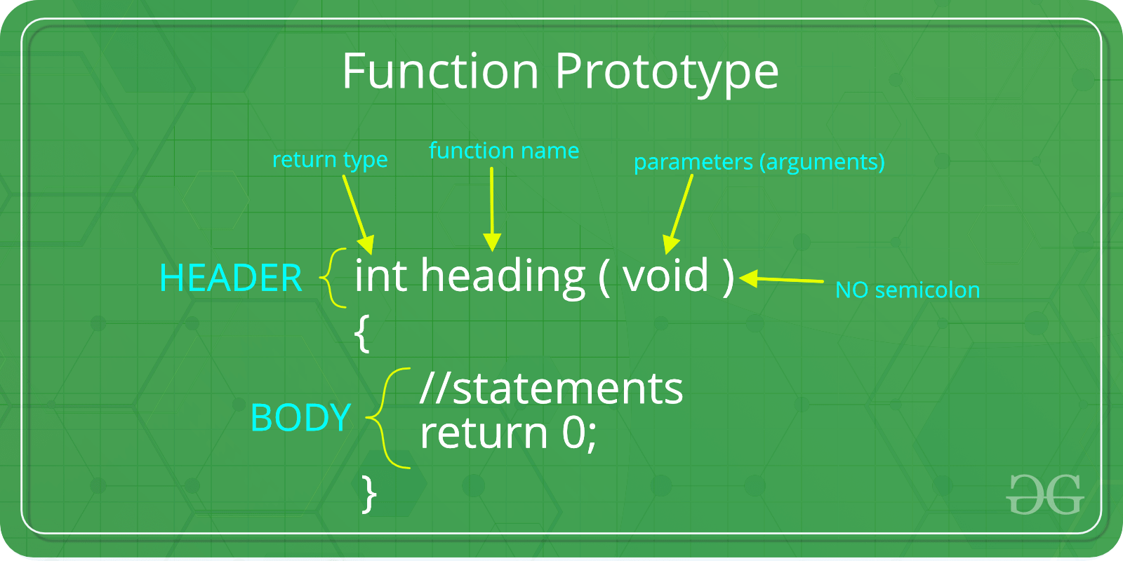
Primality test school method
#include <bits/stdc++.h>
using namespace std;
bool isPrime(int n)
{
if (n <= 1) return false;
for (int i=2; i<n; i++) {
if (n%i == 0)
return false;}
return true;
}
int main()
{
isPrime(11)? cout << " true\n": cout << " false\n";
isPrime(15)? cout << " true\n": cout << " false\n";
return 0;
}
bool isPrime(int n)
{
if (n <= 1) return false;
if (n <= 3) return true;
if (n%2 == 0 || n%3 == 0) return false;
for (int i=5; i*i<=n; i=i+6)
if (n%i == 0 || n%(i+2) == 0)
return false;
return true;
}

Slide 9
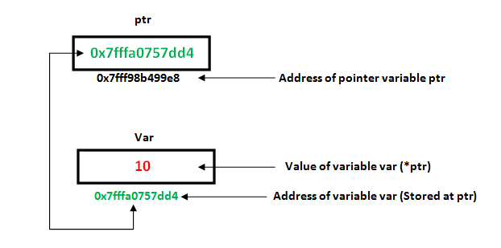
pointers
#include <stdio.h>
using namespace std;
void randomise(){
int var = 20;
int *ptr;
ptr = &var;
printf("Value at ptr = %p ",ptr);
printf("Value at var = %d ",var);
printf("Value at *ptr = %d ", *ptr);
}
void main(){
randomise();
}
Syntax:
datatype *var_name;
int *ptr;

Slide 10
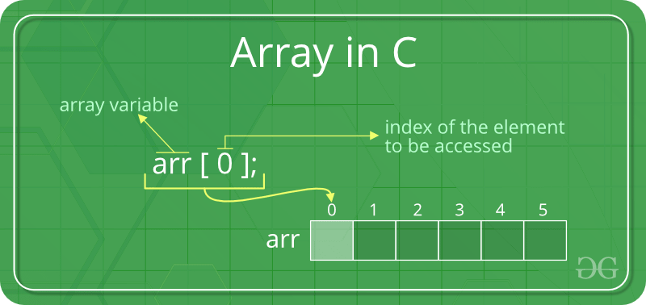
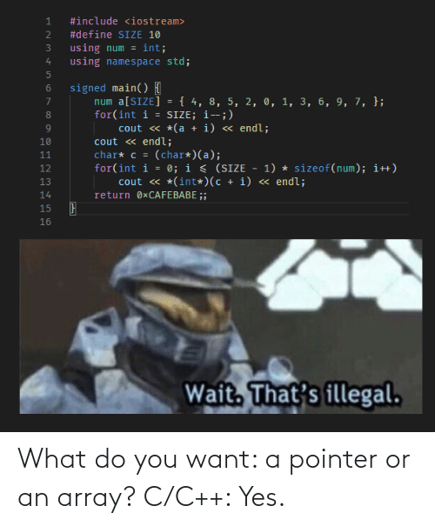
Arrays
Advantages of using arrays:
Arrays allow random access of elements. This makes accessing elements by position faster.
Arrays have better cache locality that can make a pretty big difference in performance.
Arrays represent multiple data items of the same type using a single name.
Disadvantages: 1. We must know in advance that how many elements are to be stored in array.
2. Array is static structure. It means that array is of fixed size. The memory which is allocated to array can not be increased or reduced.
3. Since array is of fixed size, if we allocate more memory than requirement then the memory space will be wasted. And if we allocate less memory than requirement, then it will create problem.
4. The elements of array are stored in consecutive memory locations. So insertions and deletions are very difficult and time consuming.

Slide 11
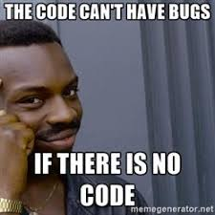
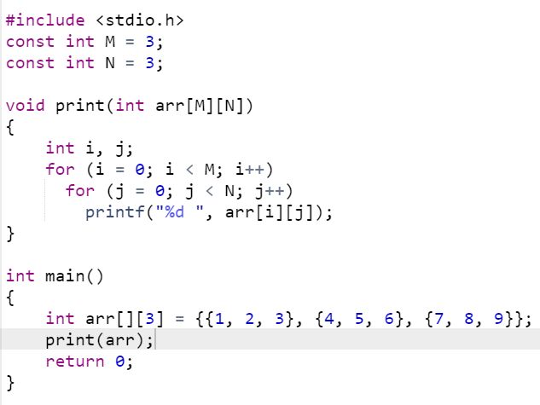
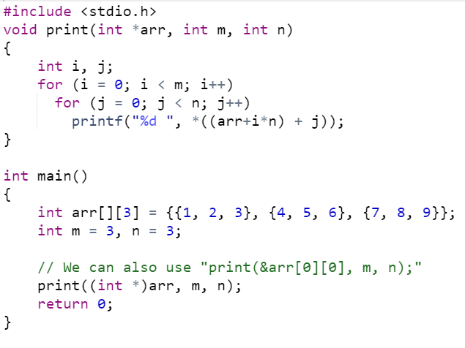
When both dimensions are available globally
Using a single pointer

Slide 12
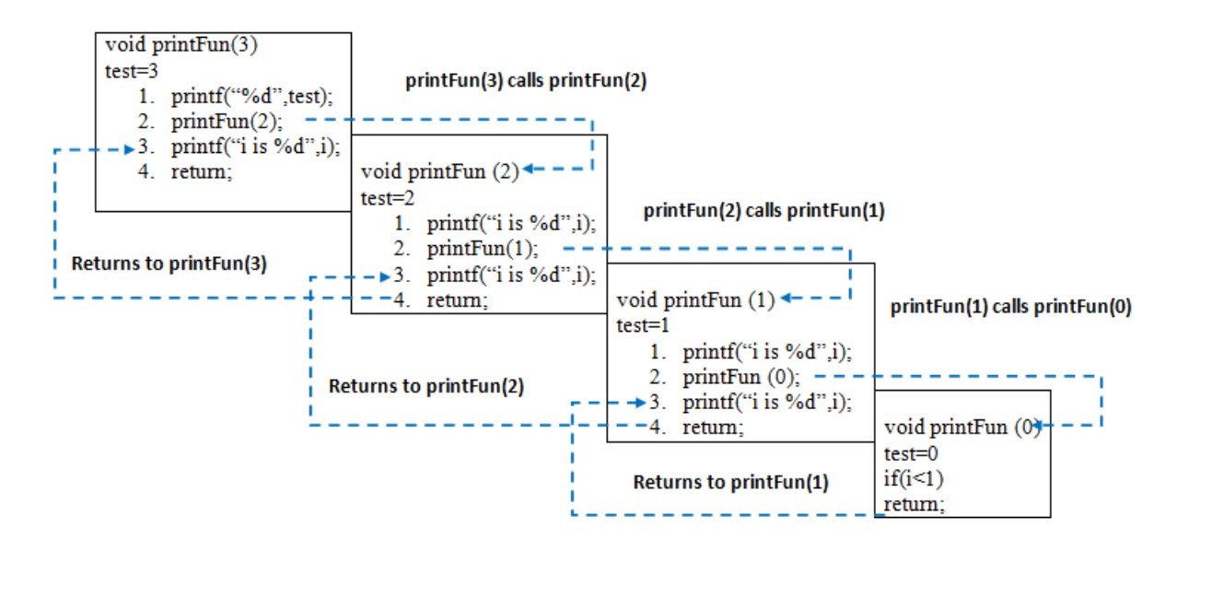
Recursions
#include <bits/stdc++.h>
using namespace std;
void printFun(int test)
{
if (test < 1)
return;
else {
cout << test << " ";
printFun(test - 1); // statement 2
cout << test << " ";
return;
}
}
int main(){
int test = 3;
printFun(test);
}

Slide 13
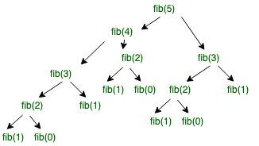
Fibonacci
int main()
{
// Initialize variable n.
int n = 5;
printf("Fibonacci series "
"of %d numbers is: ",
n);
// for loop to print the fiboancci series.
for (int i = 0; i < n; i++) {
printf("%d ", fib(i));
}
return 0;
}
// C code to implement Fibonacci series
#include <stdio.h>
int fib(int n)
{
if (n == 0) // Stop condition
return 0;
if (n == 1 || n == 2)
return 1; // Stop condition
else
return (fib(n - 1) + fib(n - 2));
}

Slide 14
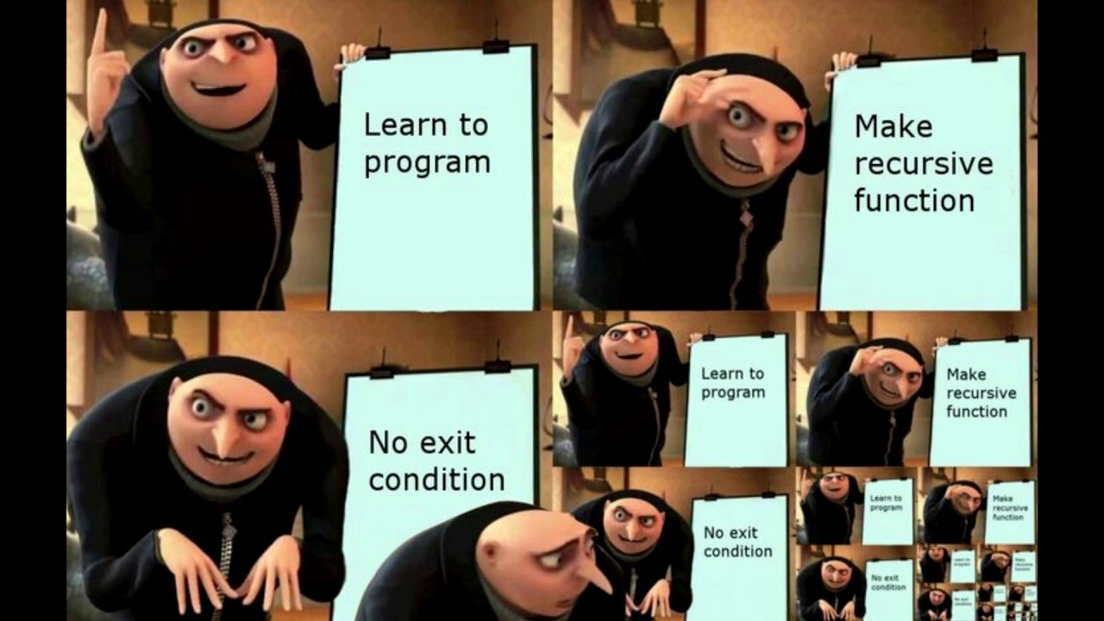
Print numbers from 1 to N without the help of loops.
Example 1:
Input: N = 10 Output: 1 2 3 4 5 6 7 8 9 10
Example 2:
Input: N = 5 Output: 1 2 3 4 5
Your Task: This is a function problem. You only need to complete the function printNos() that takes N as parameter and prints number from 1 to N recursively. The driver code adds the newline automatically after the function call.
Expected Time Complexity: O(N). Expected Auxiliary Space: O(N) (Recursive).
Constraints: 1 <= N <= 990
You are given a number n. You need to find the sum of digits of n.
Example 1:
Input: n = 1 Output: 1 Explanation: Sum of digit of 1 is 1.
Example 2:
Input: n = 99999 Output: 45 Explanation: Sum of digit of 99999 is 45.
Your Task: You don't need to read input or print anything. Your task is to complete the funsumOfDigits() that takes n as parameter and returns ction the sum of digits of n.
Expected Time Complexity: O(Logn). Expected Auxiliary Space: O(Logn) (Recursive).
Constraints: 1 <= n <= 10⁷

Slide 15
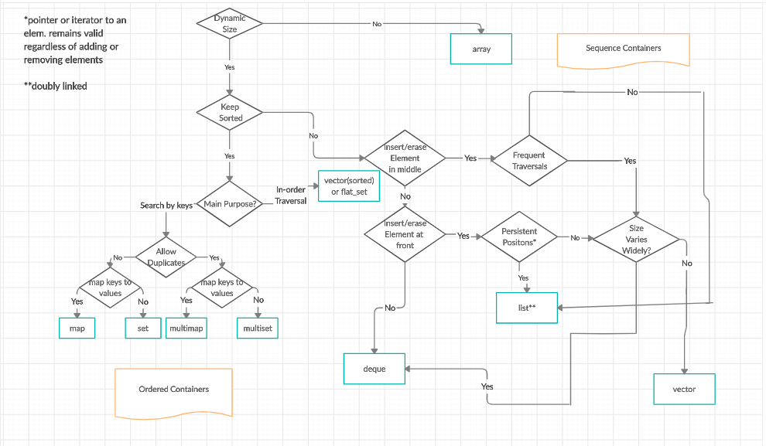
The C++ Standard Template Library (STL)
STL has four components
Algorithms
Containers
Functions
Iterators

